Slide 1
Computing Label-Constraint Reachability in Graph Databases
Hui Hong
Kent State University
Joint work with Ruoming Jin, Ning Ruan, Yang Xiang (KSU) and Haixun Wang (MSRA)

Slide 2
Outline
Introduction
Label-constraint Reachability Problem
Two classic methods
Tree-based Indexing method
Experiment Evaluation
Conclusion

Slide 3
Massive Graph Data
Huge amount of graph data being generated in real world applications
  Social Networks
  Biological Networks
  Semantic Web/Ontology
  XML/RDF
  Graph Representation of Relational Data (Keyword Query)
  Large Scale Software
Most existing research on large graph focuses on unlabeled graph (simple reachability and shortest path)

Slide 4
Edge-Labeled Graph
Often the graph is edge-labeled (and/or node-labeled)
  Edge label indicate different type of relationship
Social Network
  Vertex (people) and Edge (relationship)
  Multi-relationship graphs
  Parent-of, student-of, brother-of, friend-of, employee-of, consultant-of, follower-of…
Biological Network
  Metabolic networks
  Vertex (chemical compound) and Directed Edge (chemical reaction)
  Edge label records the enzymes which control the interaction

Slide 5
Outline
Introduction
Label-constraint Reachability Problem
Two classic methods
Tree-based Indexing method
Experiment Evaluation
Conclusion

Slide 6
Label-Constraint Reachability
Label-Constraint Reachability Query: Can u reach v through a path whose edge labels must satisfy certain member constraints?
  The path’s edge labels must be in the set of constraint labels
Social Networks: Whether person A is a remote relative of B (Is there a path from A to B where each edge label is one of parent-of, brother-of, sister-of?)
Metabolic Network: Is there a pathway between two compounds which can be activated under certain conditions?

Slide 7

LCR Query
Given vertices u and v in a labeled graph G and a label set A, is there a path from u to v with edge labels in A?
e
0
c
e
e
1
2
a
3
a
b
b
d
Q1: Can vertex 0 reach 9 only through edge labels { a,b,c } ?
b
4
5
b
6
a
c
a
b
7
8
9
Yes
b
a
b
d
d
c
b
Can vertex 0 reach 9 only through edge labels { a,b } ?
a
10
11
12
c
a
b
b
13
14
15
No

Slide 8
The Challenge
Traditional Reachability Indexing cannot be easily extended to handle the label information
A special case of regular simple path query (NP-complete)
  General indexing method based on equivalent classes and refinement is too expensive
Two simple alternatives
  Online Search (DFS/BFS)
  Generalized Transitive Closure

Slide 9
Outline
Introduction
Label-constraint Reachability Problem
Two classic methods
Tree-based Indexing method
Experiment Evaluation
Conclusion

Slide 10
Depth First Search
0
e
0
c
e
e
1
a
3
2
3
a
b
b
d
b
4
b
6
5
6
Can vertex 0 reach 9 only through edge labels { a,b,c } ?
a
c
a
b
7
8
9
b
a
b
d
d
c
b
a
10
11
12
c
a
b
b
Result: Yes
Complexity: O(|V|+|E|)
13
14
15
May speedup with “focused” procedure using traditional index

Slide 11
Generalized Transitive Closure
Precompute the path-label set for any pair
e
0
c
Q1: Can vertex 0 reach 9 only through edge labels { a,b,c } ?
e
e
1
2
a
3
a
b
b
d
b
4
5
b
6
abcde
a
c
a
b
7
8
9
abcd
abce
bcde
b
a
b
d
d
c
b
a
abc
bce
10
11
12
c
a
b
b
be
13
14
15

Slide 12
Research Problems
Compression
  Can we compress and index the generalized transitive closure (all-pair minimal sufficient path label sets?)
Scalability
  Can we compute such compression without fully materializing the generalized transitive closure?
Query Answering
  How to utilize such compression/indexing for query answering?

Slide 13
Outline
Introduction
Label-constraint Reachability Problem
Two classic methods
Tree-based Indexing method
Experiment Evaluation
Conclusion

Slide 14
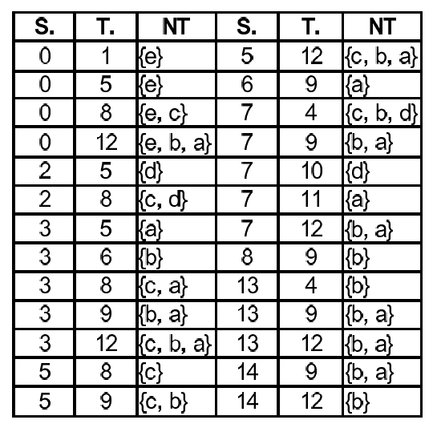
Tree-based Index Framework (Compression)
0
e
0
c
e
e
1
2
3
b
a
a
b
d
4
b
5
b
6
a
c
a
b
7
8
9
b
a
d
b
d
b
a
10
11
12
c
c
a
b
b
13
14
15
Spanning Tree
Partial Transitive Closure (NT)

Slide 15
Partial Transitive Closure
Non-Tree Path starts and ends with a non-tree edge
NT(u,v) records those minimal sufficient path labels, which only appear in some non-tree path from u to v
0
e
0
c
A non-tree path from 0 to 12: 0->5->8->11->14->12
e
e
1
2
3
b
a
a
b
NT is typically only a small portion of the full transitive closure!
Tree-paths which begin and/or end with tree edge can effectively reduce NT!
d
4
b
5
b
6
a
c
a
b
7
8
9
b
a
d
b
d
c
b
a
10
11
12
c
a
b
b
13
14
15

Slide 16
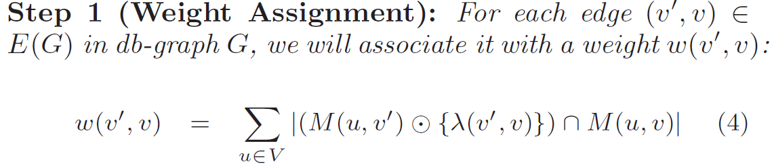
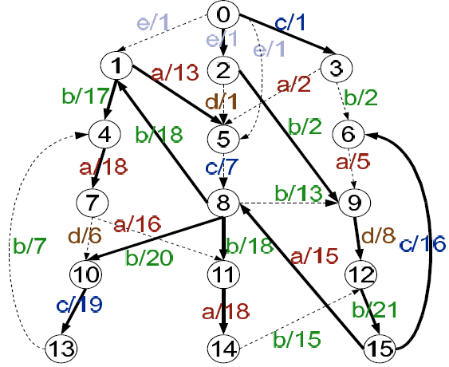
Maximal Spanning Tree for Minimizing NT
Assign weight to each edge (the number of sufficient path-labels which can reach v via edge (v’,v))
Edge label
M(u,v’): Minimal sufficient path label set
from u to v’
M(u,v): Minimal sufficient path label set
from u to v
For computing weight for edge (8,11), consider the number of sufficient path-labels from vertex 0 to 8.
W(8,11)=18 is to sum over all vertices to vertex 8!

Slide 17
Efficient Query Processing
T+NT: Need recover all path labels from u to v using Spanning Tree T and Partial Transitive Closure NT
Three-segment path decomposition scheme:
  Segment 1: In-tree path from u to x (u’s child);
  Segment 2: non-tree path from x to y (v’s ancestor)
  Segment 3: In-tree paths from y to v
u
Segment 1: In-tree Path Label
x
Segment 2: NT
y
Segment 3: In-tree Path Label
v

Slide 18
Outline
Introduction
Label-constraint Reachability Problem
Two classic methods
Tree-based Indexing method
Experiment Evaluation
Conclusion

Slide 19
Experimental Evaluation
How effective (compression) and efficient (query answering) is the spanning tree indexing?
How accurate (scalability) is the sampling MST?
Benchmarks
  Online DFS and Focused DFS
  Fully Materialized Transitive Closure (Warshall)
  True MST (Opt-Tree)
  Approximate MST (Sampling-Tree)

Slide 20
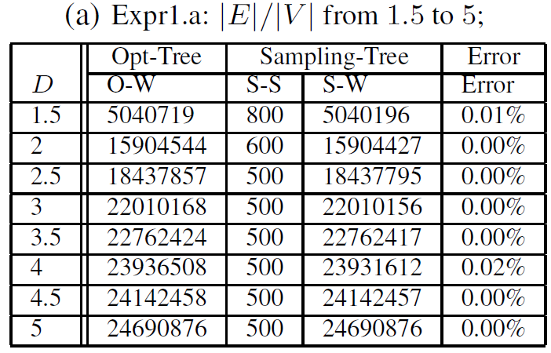
Sampling Accuracy (Vary density, |V|=5000, ER)

Slide 21
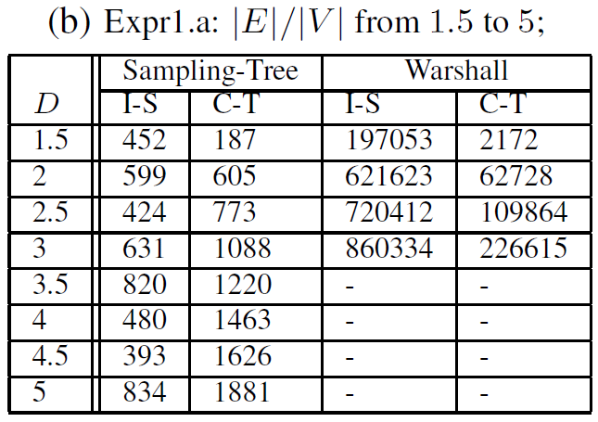
Index Size (KB) and
Construction Time (in sec.)

Slide 22
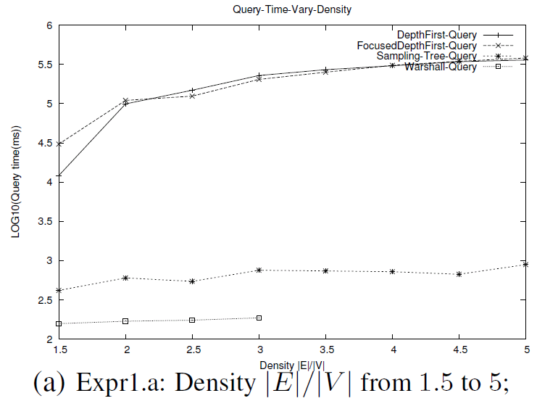
Query Time (10,000 Queries in ms)

Slide 23
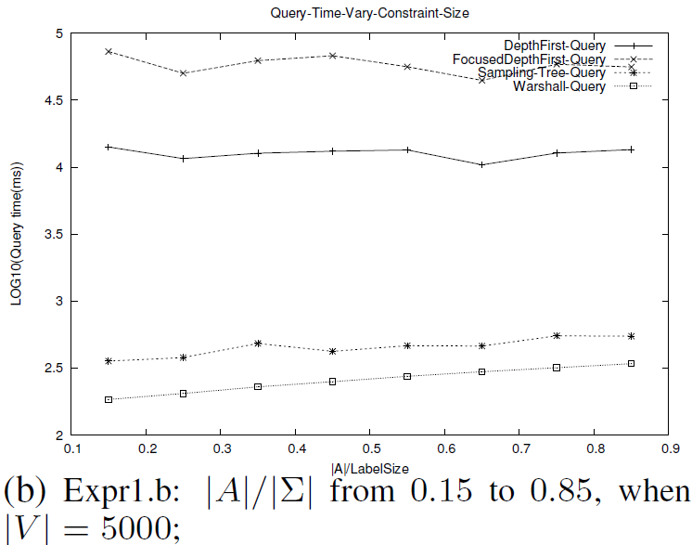
Query Time
(Varying Constraint Size)

Slide 24
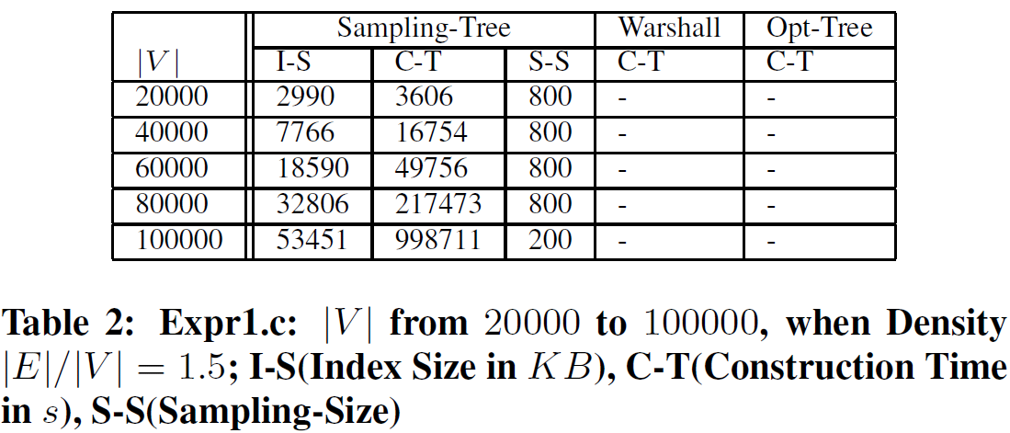
Scalability (Index Size, Construction Time, and Sampling Size)

Slide 25
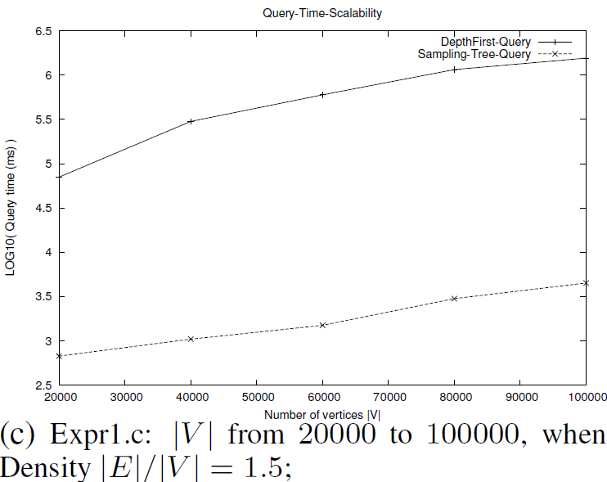
Query Time (Scalability, ER)

Slide 26
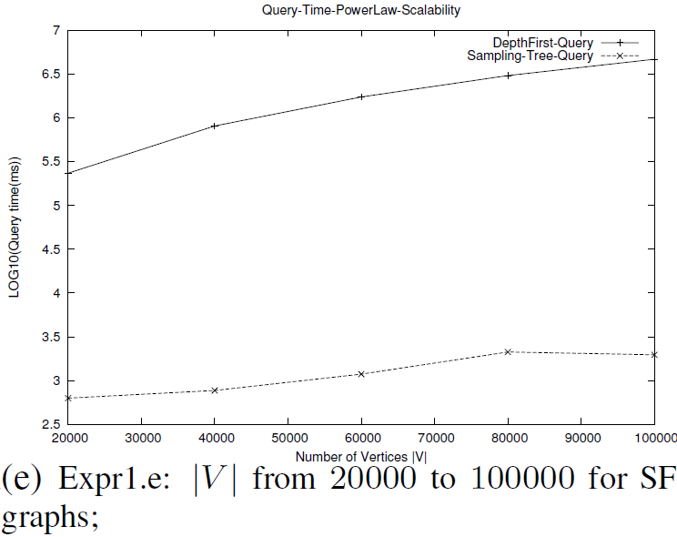
Query Time (Scalability, SF)

Slide 27
Conclusion
The Tree-based method excell other two methods in terms of query time and index size.
400 faster than DFS.
5% of Warshall Index size.

Slide 28
References
[1] Serge Abiteboul and Victor Vianu. Regular path queries with constraints. In PODS, pages 122–133, 1997.
[2] R. Agrawal, A. Borgida, and H. V. Jagadish. Efficient management of transitive relationships in large data and knowledge bases. In SIGMOD, pages 253–262, 1989.
[3] Ian Anderson. Combinatorics of Finite Sets. Clarendon Press,Oxford, 1987.
[4] A. L. Barabasi and R. Albert. Emergence of scaling in random networks. Science, 286(5439):509–512, 1999.
[5] M.de Berg, M.van Kreveld, M.Overmars, and O.Schwarzkopf. Computational Geometry. Springer, 2000.
[6] Deepayan Chakrabarti, Yiping Zhan, and Christos Faloutsos. R-mat: A recursive model for graph mining. In Fourth SIAM InternationalConference on Data Mining, 2004.
[7] Y. J. Chu and T. H. Liu. On the shortest arborescence of a directed graph. Science Sinica, 14:1396–1400, 1965.
[8] Thomas H. Cormen, Charles E. Leiserson, and Ronald L. Rivest.Introduction to Algorithms. McGraw Hill, 1990.
[9] J. Edmonds. Optimum branchings. J. Research of the National Bureau of Standards, 71B:233–240, 1967.
[10] Gang Gou and Rada Chirkova. Efficiently querying large xml data repositories: A survey. IEEE Trans. Knowl. Data Eng.,19(10):1381–1403, 2007.
[11] V. Heidrich-Meisner and C. Igel. Hoeffding and bernstein races for selecting policies in evolutionary direct policy search. In ICML ’09.
[12] W. Hoeffding. Probability inequalities for sums of bounded random variables. Journal of the American Statistical Association, 58(301):13–30, March 1963.
[13] Thorsson V Ranish JA Christmas R Buhler J Eng JK Bumgarner R Goodlett DR Aebersold R Hood L. Ideker, T. Integrated genomic andproteomic analyses of a systematically perturbed metabolic network. In Science, pages 929–934, 2001.
[14] R. Jin, H. Hong, H. Wang, N. Ruan, and Y. Xiang. Computing label-constraint reachability in graph databases. Technical Report TR-KSU-CS-2010-1, Computer Science, Kent State University, March 2010.

Slide 29
Thanks!!!
Questions?

Slide 30
Minimal Sufficient Path-Label Set
M(u,v)
abcde
Sufficient Path-Label Set
abcd
abce
bcde
abc
bce
Minimal Sufficient Path-Label Set
be
Dynamic Programming (Generalized Floyd-Warshall Algorithm) can compute all pair minimal sufficient path-label sets

Slide 31
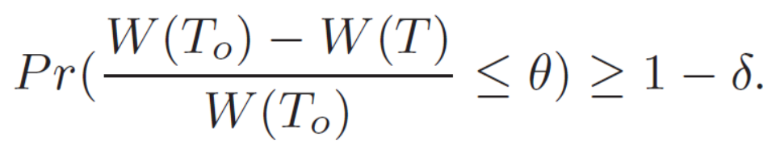
Scalable Index Construction (Scalability)
Computing MST needs the generalized transitive closure M
  All pair minimal sufficient label sets
  computationally expensive/ Memory cost
Can we avoid the fully materialization of M?
Approximate MST Problem
  With high probability (at least 1-δ ), the relative difference between the approximate MST and the true MST is small (no higher than θ)

Slide 32
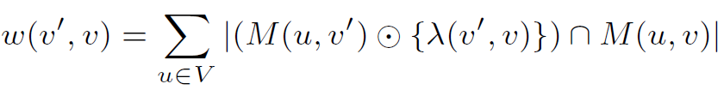
Estimating Edge Weight by Sampling
The total weight of each edge=Sum of sub weight for each vertex u
Instead of calculating the sub weight from every vertex, we do sampling.
Considering edge (8,11).
Sample from vertex 0;
Single Source M(0,*)
Sample from vertex 1;
Single Source M(1,*)

Slide 33
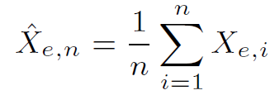
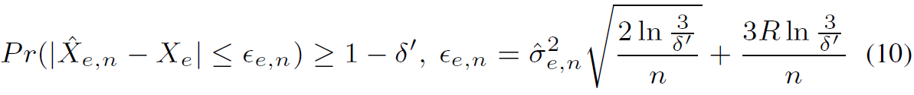


Edge Weight Estimation and Error Bound
Sampling estimator:
Error Bound (Confidence Interval):
Hoeffding and Bernstein Bound
Bonferroni inequality

Slide 34
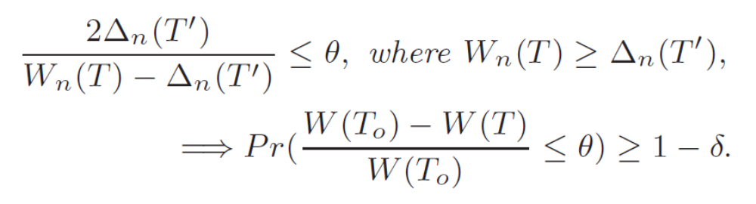
Approximate MST Construction
Key Question: How close is the total exact weight of approximate MST discovered based on the estimated edge weights compared with the total exact weight of true MST?
Sampling Size: when should we stop sampling?
Double-Tree Test:
  T: MST discovered based on sampling edge weights
  T’: MST discovered based on the error bound as weight

Slide 35

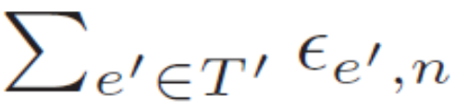
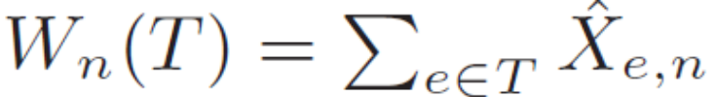
Double-Tree Test
Total Error in MST T’
Total Estimated Edge Weight in MST T
Using the estimates and error bound in sampling, DTT can
determine how good is the discovered approximate MST
with respect to the true MST based on the exact weight!

Slide 36
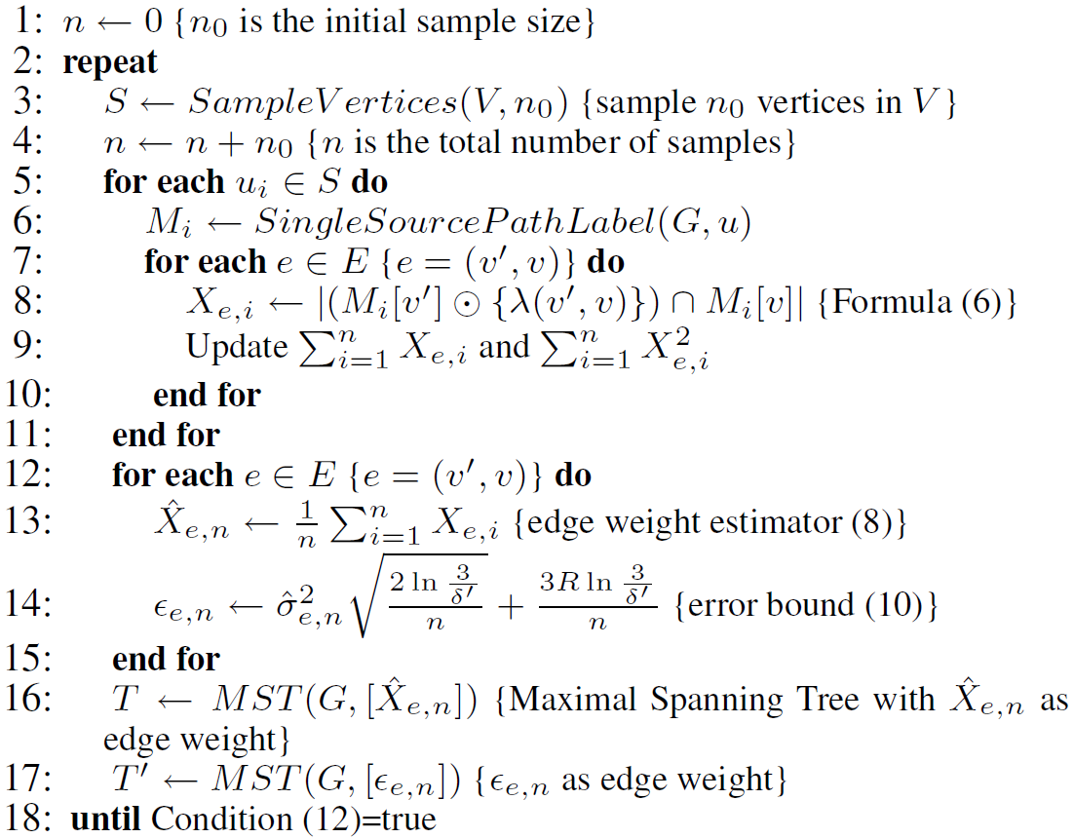
Approximate MST Algorithm
Computing Single Source M(u,*) and edge subweight

Slide 37
Approximate MST Algorithm
Weight and error bound estimation

Slide 38
Approximate MST Algorithm
Compute two maximal spanning trees, maximal total weight and
maximal total error, then apply Double-Tree Test!

Slide 39
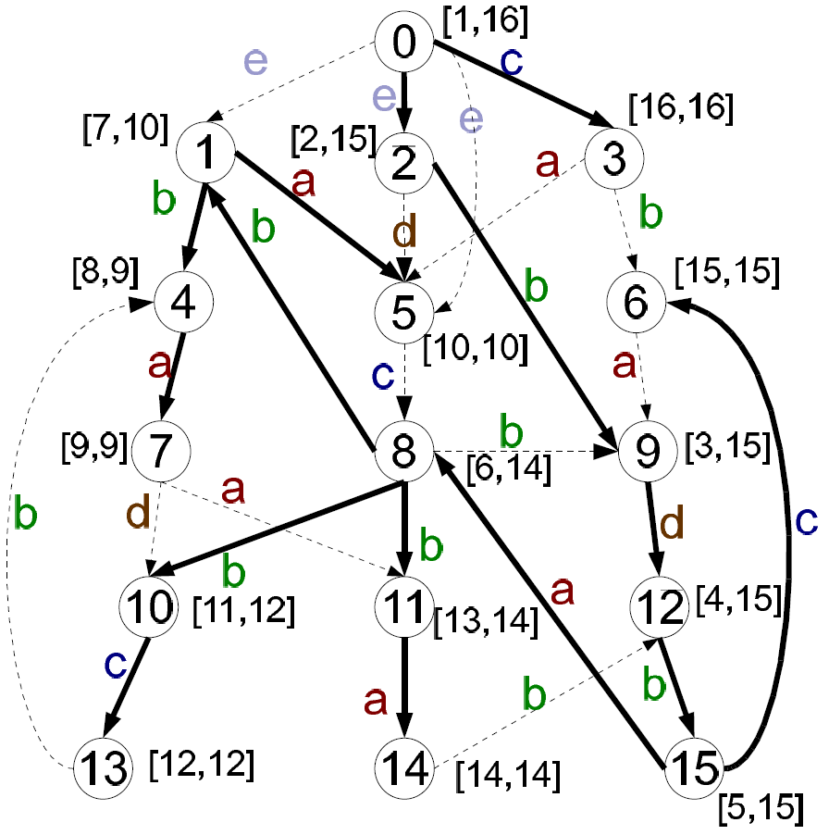
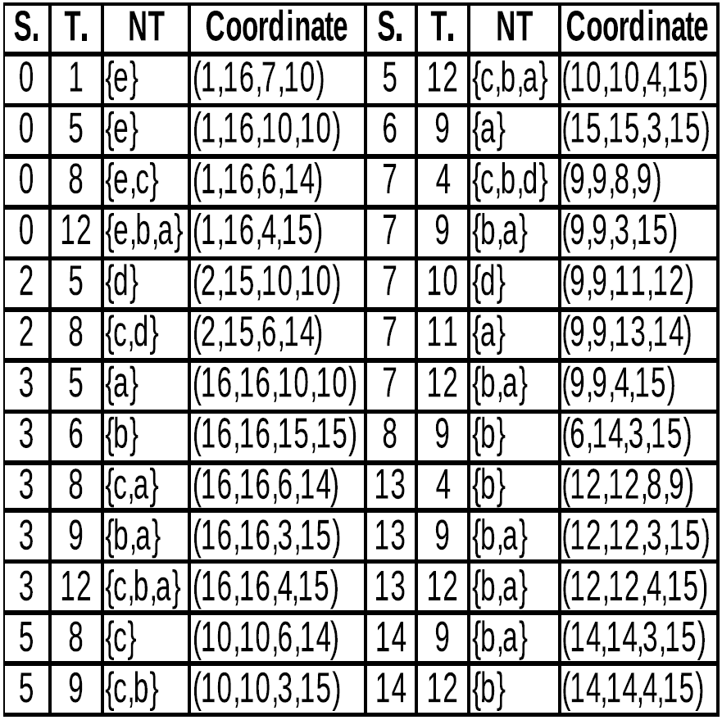
Mapping NT to Four-Dimensional Space
(u.preorder, u.postorder, v.preorder, v.postorder)

Slide 40
Query Example
Range in 4-dimensions: [2,15], [2,15], [1,5], [15,16]

